Slide 1


Sign Language To Text
Oren Raz and Lam Kai Yi Karen

Slide 2
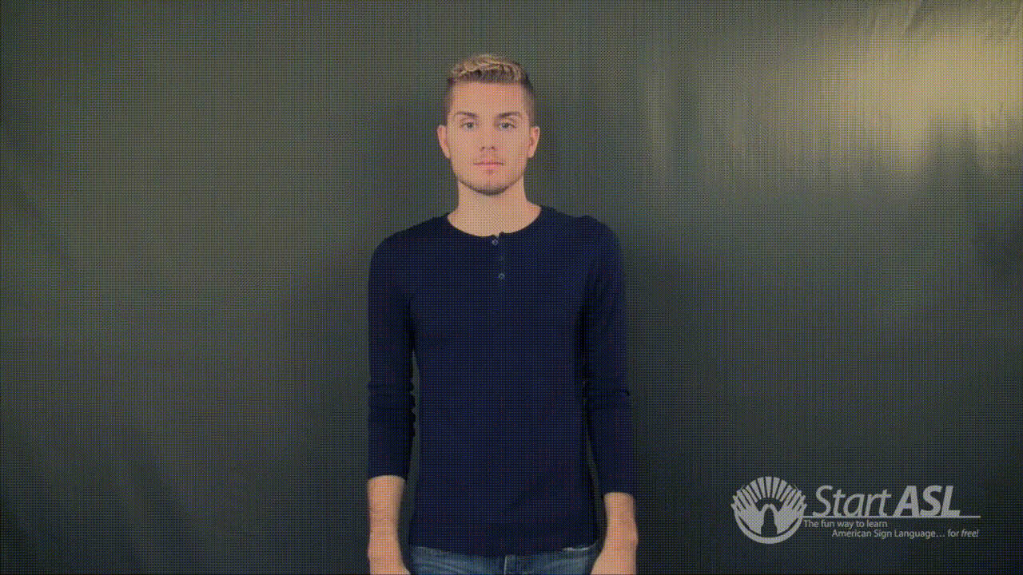
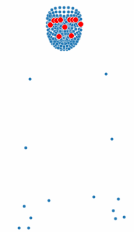
RECAP
Subset
274 videos in in total for 32 words
Train: 194 videos, Validation: 46 videos
AIM: Translate Word Level Sign Language to Text
In ONE Video
Variable n number of frames
543 Landmark Points (x, y, z coordinates)
Exclude Face Points -->
75 Left
Shape: (194, n, 75, 3)

Slide 3
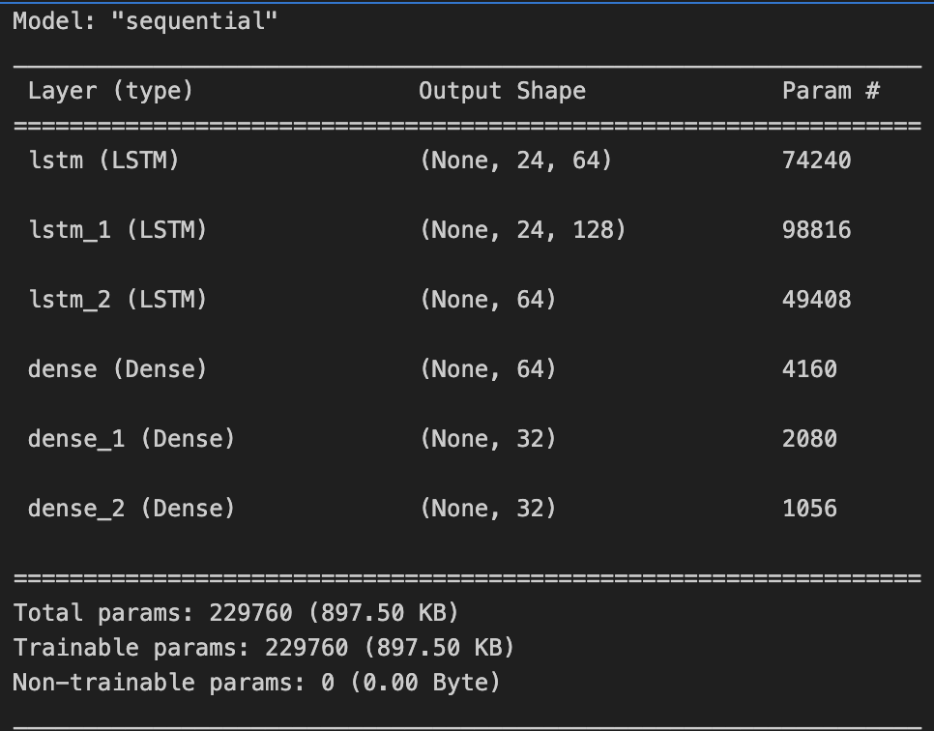
RECAP
Subset
274 videos in in total for 32 words
Train: 194 videos, Validation: 46 videos
AIM: Translate Word Level Sign Language to Text
Flatten + Fix number of frames
Long Short Term Memory (LSTM) Model
In ONE Video
Variable n number of frames
543 Landmark Points (x, y, z coordinates)
Exclude Face Points -->
75 Left
Shape: (194, 24, 225)

Slide 4
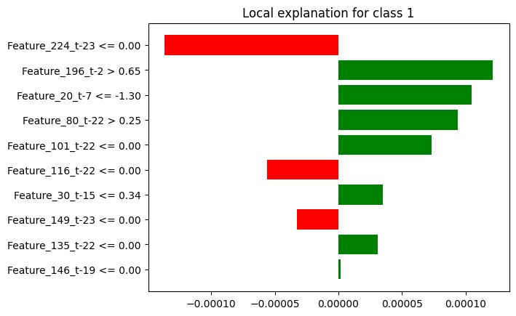
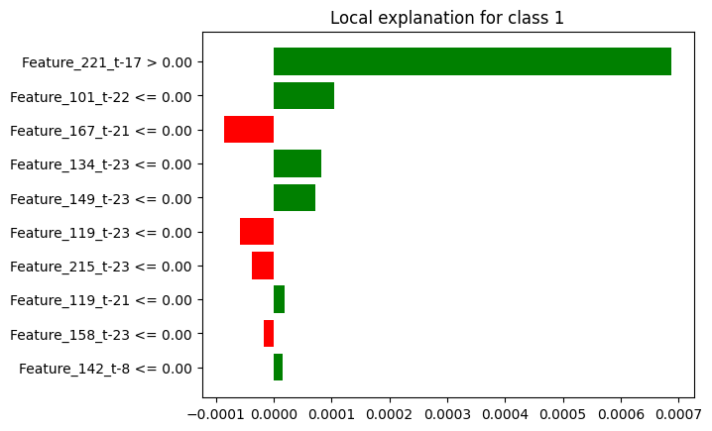
Application of Explainability Method
Attempts with LIME
Problems Encountered:
Approximation by LIME resulted in varying explanation for the same sample
Features used in this model are not really explainable --> Results of LIME does not provide more information on how the model work

Slide 5
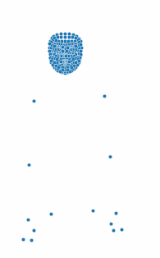
Application of Explainability Method
Proposed Method to Explain the Model
Try to find the critical landmark points / points that are contributing the most to the model prediction
Mark it out on the video
Get feedback from people with the knowledge of sign language on the accuracy of the points

Slide 6

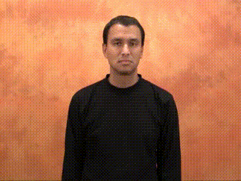

Analysis of Model Predictions and Feature Impact
Word = "short"

